Slide 1
Agenda for today
Today we will do another tutorial example to continue introduction to Lumerical FDTD software.
Task #1: Tune the resonance frequency of a gold nanobar using the parametric sweep feature of Lumerical FDTD.
Task #2: Calculate the Q-factor of the resonant mode
Next week: Begin discussing waveguide simulations

Slide 2
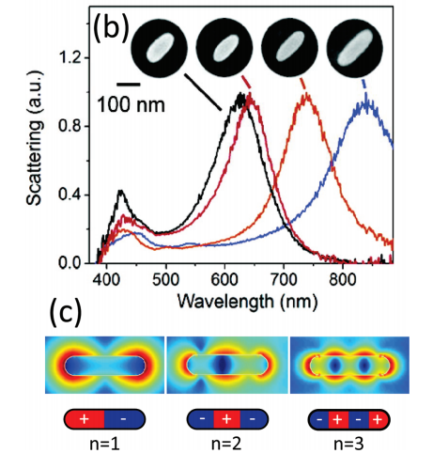
Gold nanobar antennas
Gold nanobars behave like dipole antennas and resonantly scatter light.
Resonance length is roughly $λ/2$ (same as dipole antenna) but typically smaller than this because of kinetic inductance (i.e. electron lags behind field causing the “plasmonic” effect).

Slide 3
Circuit model of dipole antenna
Let’s analyze dipole antenna using circuit model
E
C
B
C
+
+
+
I
-
-
-
a
L
L
L
h
$$C≅\frac{πε_{0}h}{\ln\left(h/a\right)}$$
$$L_{f}≅\frac{μ_{0}h}{2π}\ln\left(\frac{h}{a}\right)$$
$$ω=\frac{1}{\sqrt{LC}}=\frac{2πc}{λ}$$
R = R_{rad} + R_{loss}
$$2h=\frac{2λ}{\sqrt{2}π}≅0.45λ$$
Lumped circuit:
Pretty close to $2h=λ/2$
In reality, $2h≅0.48λ$
(depends on wire radius)
L
C
See: www.physics.princeton.edu/~mcdonald/examples/cap_antenna.pdf

Slide 4
Optimizing gold nanobar resonance
PML
Plane wave
Using Lumerical FDTD, we would like to optimize the length of a gold nanobar such that the resonance wavelength of the nanobar is roughly 800nm
We will use broadband plane wave source to excite the gold nanobar embedded in air medium.
Computational domain will be terminated by PML on all sides
PML
PML
nanobar
length
PML

Slide 5
Create ‘nanobar’ geometry
We will create a rectangle consisting of gold.
To create a rectangle and edit the properties:
Structures → Rectangle
Right click on rectangle in Objects Tree; select Edit object

Slide 6
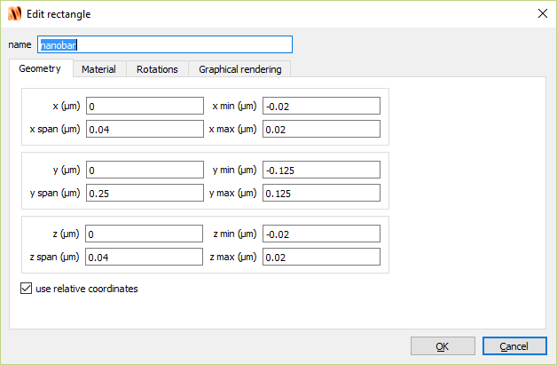
Create ‘nanobar’ geometry

Slide 7
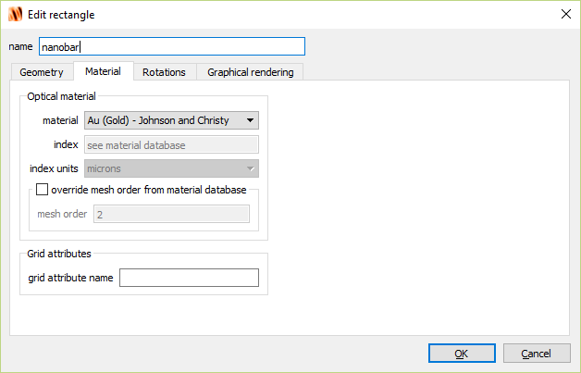
Create ‘nanobar’ geometry

Slide 8
Create simulation window
To create a simulation window and edit the properties:
Simulation → Region
Right click on FDTD in Objects Tree; select Edit object

Slide 9
Create simulation window

Slide 10
Create simulation window

Slide 11
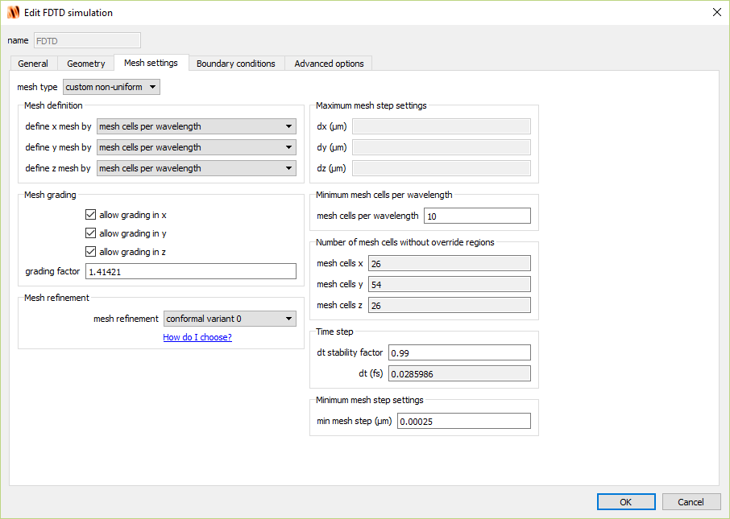
Create simulation window

Slide 12
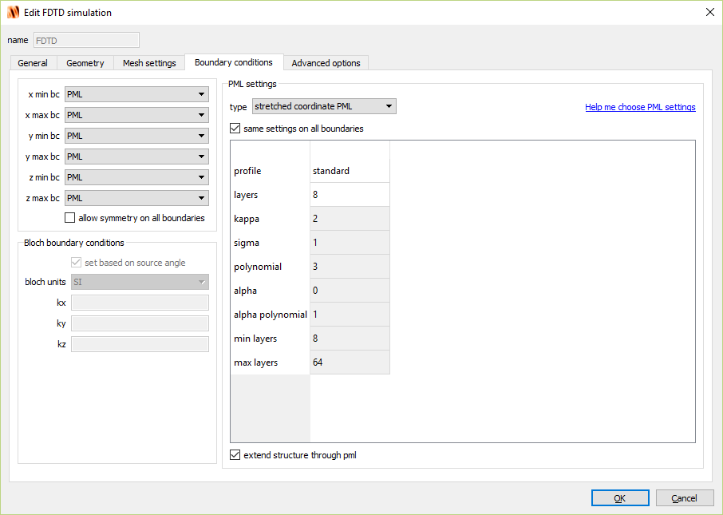
Create simulation window

Slide 13
Create mesh refinement
To create a simulation window and edit the properties:
Simulation → Mesh
Right click on mesh in Objects Tree; select Edit object

Slide 14
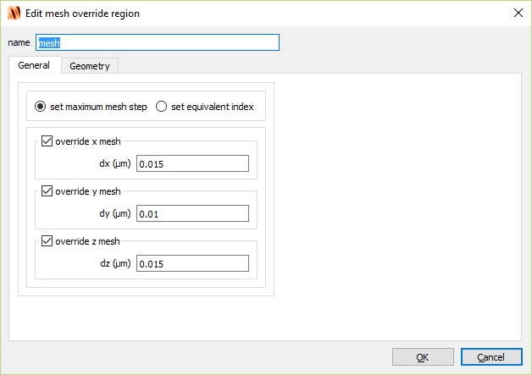
Create mesh refinement

Slide 15
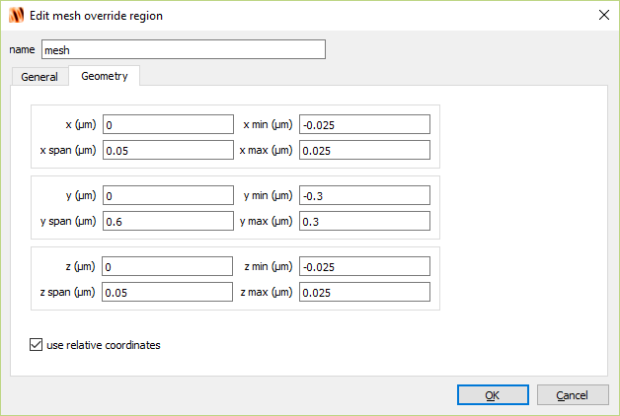
Create mesh refinement

Slide 16
Create source
To create a source and edit the properties:
Sources → Plane wave
Right click on source in Objects Tree; select Edit object

Slide 17
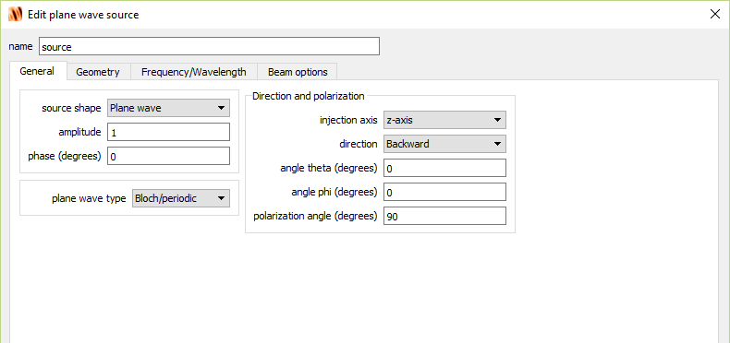
Create source
Bloch/periodic: most common. Technically should only be used for PBCs, will cause diffraction effects at edges for PML. OK far from edges.
BFAST: used for angled plane waves with PBCs.
Diffracting: used for diffraction from rectangular aperture (set by source size).

Slide 18
Create source

Slide 19
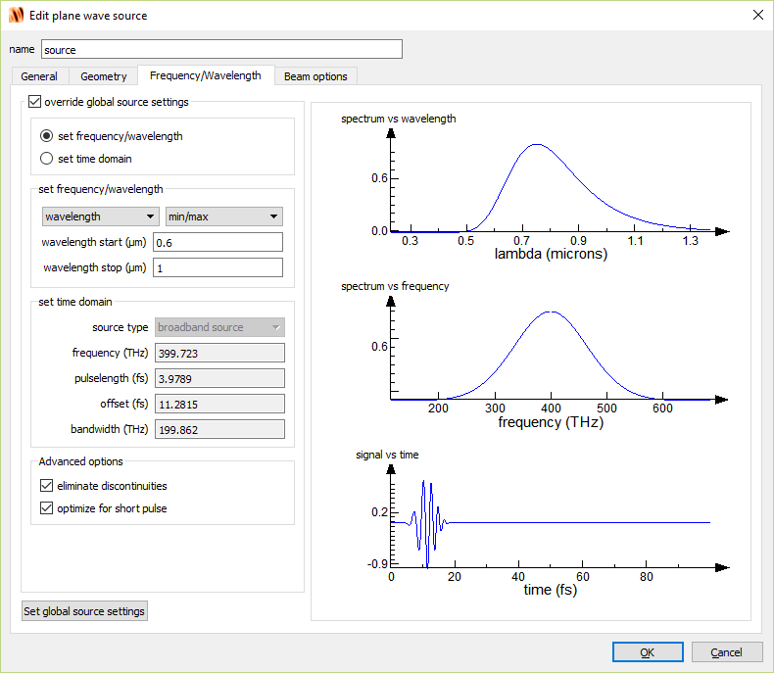
Create source

Slide 20
Create field monitor
To create a monitor and edit the properties:
Monitors → Frequency-domain field and power
Right click on DFTMonitor in Objects Tree; select Edit object

Slide 21
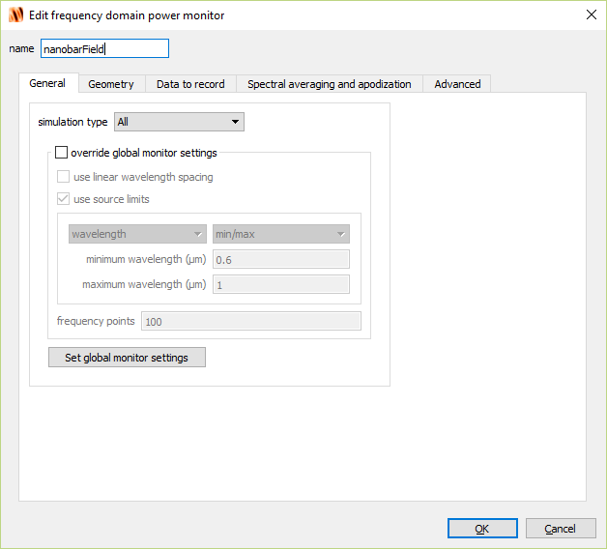
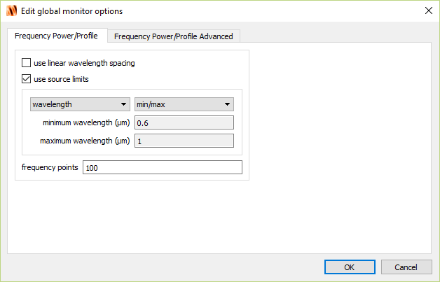
Create field monitor

Slide 22
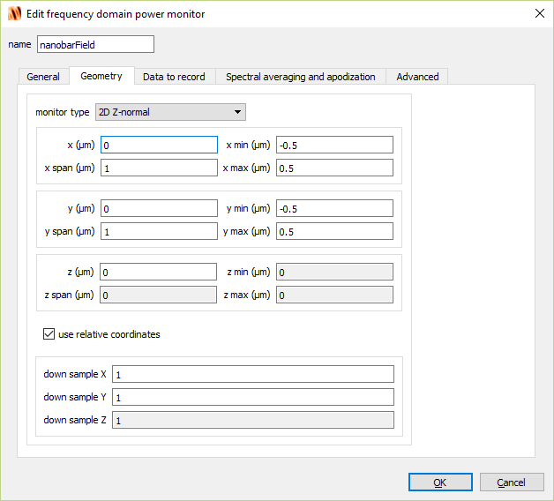
Create field monitor

Slide 23
Create movie monitor
To create a monitor and edit the properties:
Monitors → Movie
Right click on MovieMonitor in Objects Tree; select Edit object

Slide 24
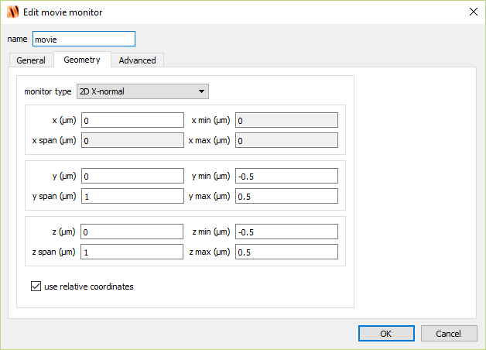
Create movie monitor

Slide 25
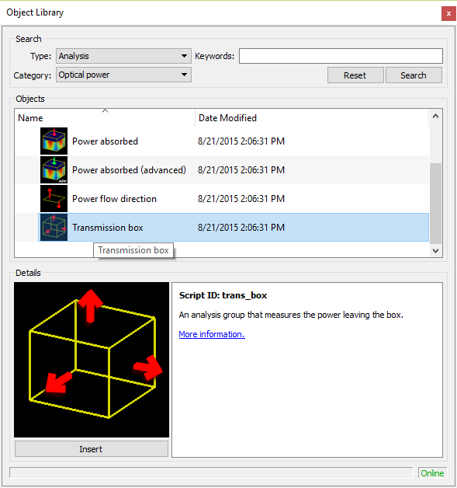
Create transmission box
To create a transmission box and edit the properties:
Analysis → Optical Power
Select Transmission box and hit Insert

Slide 26
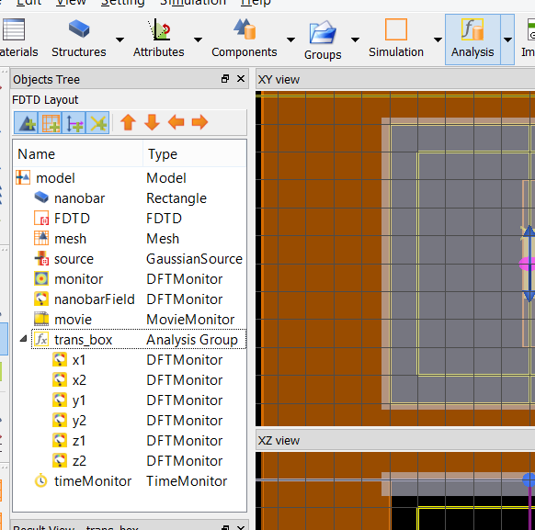
Analysis tab
Contains specialized analyses using grouped objects and scripts
More on this later…

Slide 27
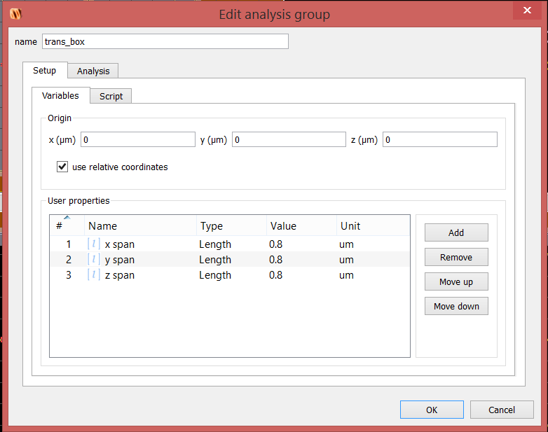
Create transmission box

Slide 28
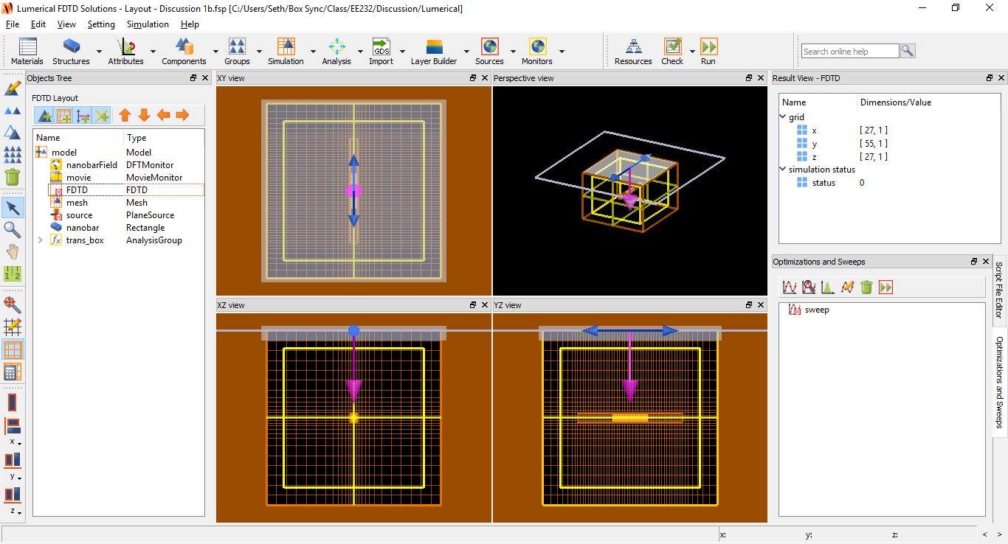
Run simulation
Click the Run icon

Slide 29
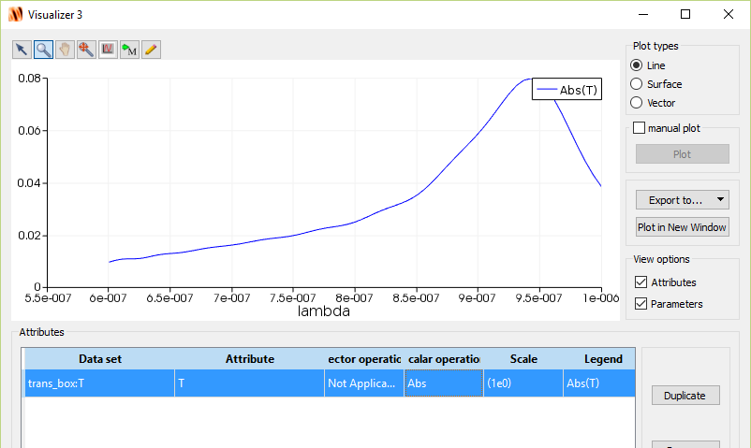
Analyze transmission box
Right-click trans_box → visualize → T
Select Abs for the Scalar Operation

Slide 30
Analyze transmission box
Transmission box measures net power that leaves the box.
The nanobar absorbs energy and therefore the net power is negative because of loss.
We observe resonance peak close to 950nm. Let’s try to optimize nanobar length to push the resonance closer to 800nm

Slide 31
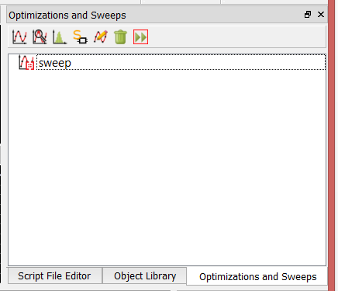
Parameter sweep
Let’s fine-tune the nanobar length so that resonance peak occurs closer to 800nm.
Select Optimizations and Sweeps toolbar.
Click the icon Create New Parameter Sweep
Right-click sweep and click Edit

Slide 32
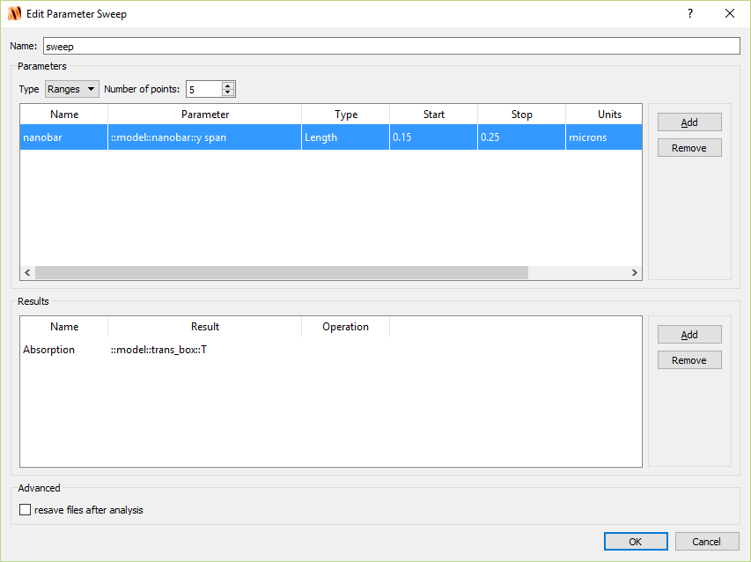
Parameter sweep

Slide 33
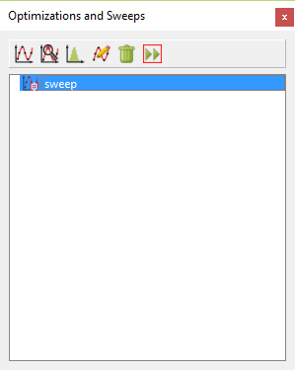
Parameter sweep
Click Run icon

Slide 34
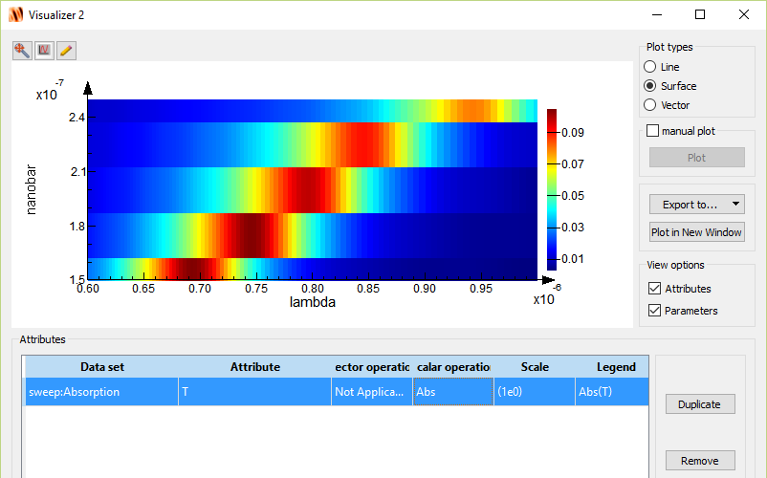
Analyze parameter sweep
Right click Sweep, select Visualize → Absorption
Select Abs for scalar operation

Slide 35
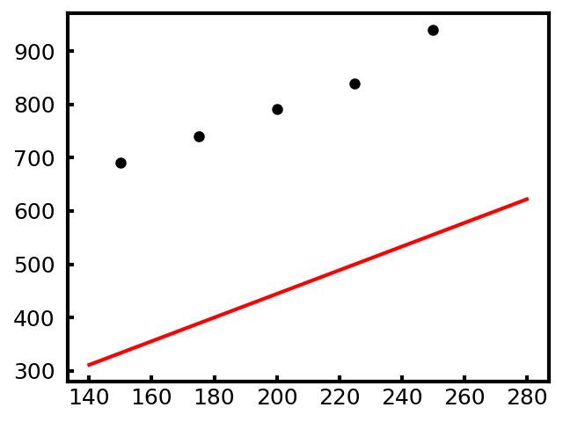
Comparison with theory
Not even close to ${l=λ}/2$!
What’s wrong?
Simulation
Resonance wavelength (nm)
Circuit model
Nanobar length (nm)

Slide 36
Comparison with theory
We forgot kinetic inductance!
Electron motion lags with respect to applied field
$$F=m_{tot}a=mN\frac{dv}{dt}=qN\frac{V}{l}$$
$$I=\frac{qNv}{l}$$
$$V=L_{k}\frac{dI}{dt}$$
$$L_{k}=\frac{ml}{q^{2}nA}$$
A
$$l$$
$n=$ electron density
$m=$ electron mass
$$F$$
N electrons
R = R_{rad} + R_{loss}
Lumped circuit:
L = L_{f} + L_{k}
C
See: EE236A

Slide 37
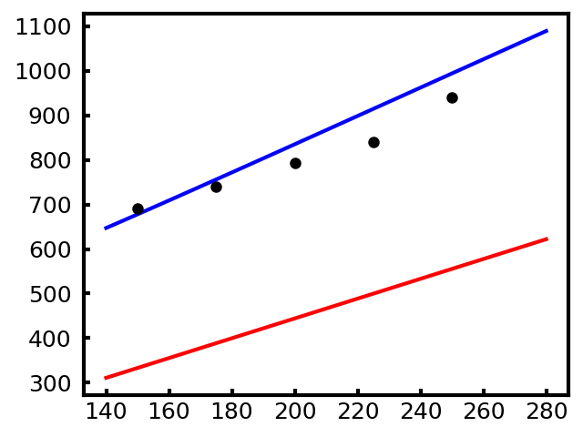
Comparison with theory
Much better match by including L_{k}
Circuit model with L_{k}
Resonance wavelength (nm)
Simulation
Circuit model
Nanobar length (nm)

Slide 38
Analyze parameter sweep
Goal was resonance at 800 nm $→$ Nanobar length of 200 nm
Change the nanobar object such that y-span is 200nm and re-run the (non-parametric sweep) simulation to analyze the field-monitor data.

Slide 39
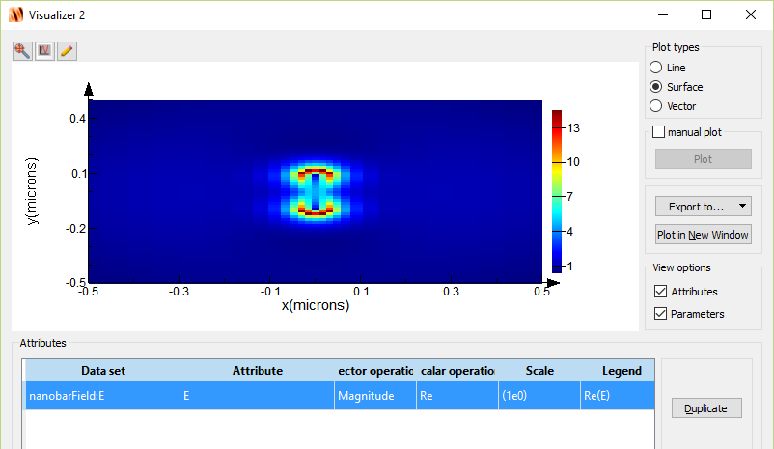
Analyze field-monitor
Right-click nanobarField → visualize → E
Click lambda in the Parameters window.
Drag the slider until Value ~ 0.8
Dipole-mode
field is large at both ends of the nanobar

Slide 40
Movie monitor

Slide 41
Q-factor of resonance
$$Δf$$
$$Q=\frac{f}{Δf}\sim \frac{380 THz}{60 THz}=6.3$$

Slide 42
Q-factor of resonance
Less ambiguous if we measure the Q-factor in the time domain.
Recall for a general “cavity”
Therefore if we plot the field energy on dB scale we can take the linear slope of the line (m) and relate it to Q as:
$$I\left(t\right)=I_{0}e^{−ω_{0}t/Q}$$
$$10\log_{10}{I\left(t\right)}=10\log_{10}{I_{0}}−10\frac{ωt}{Q}\log_{10}{(e)}$$
$$Q=−10\frac{ω}{m}\log_{10}{(e)}$$

Slide 43
Create time monitor
To create a time monitor and edit the properties:
Monitors → Field time
Right click on TimeMonitor in Objects Tree; select Edit object

Slide 44
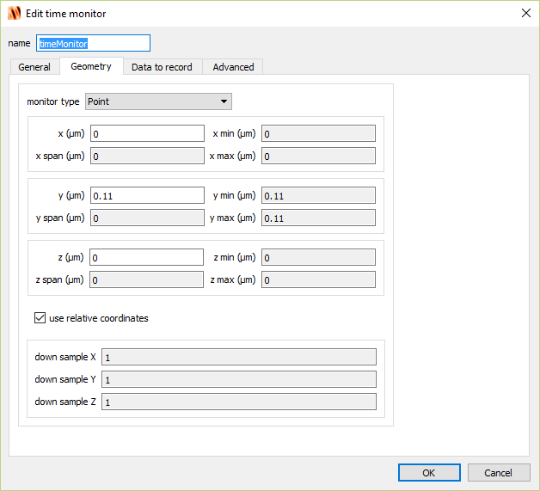
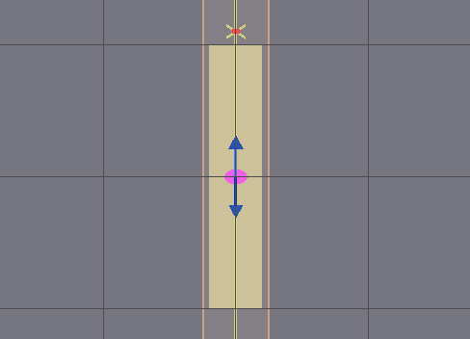
Create time monitor
XY view

Slide 45
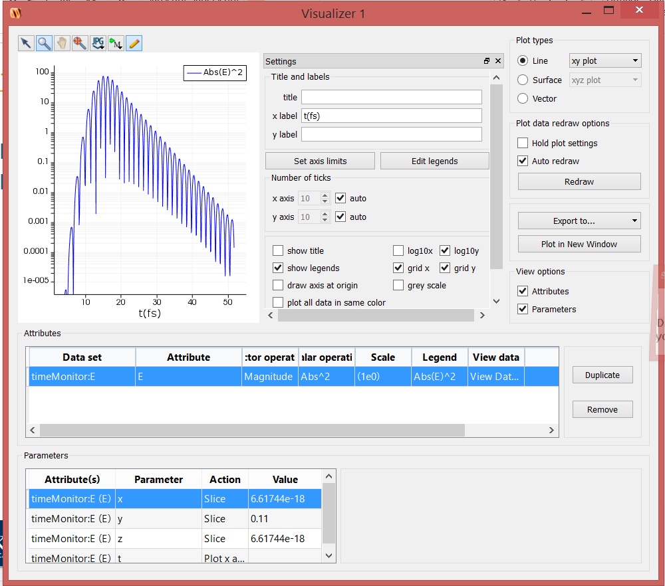
Analyze time-domain result
Run simulation
Right-click timeMonitor→ Visualize→ E
For energy density

Slide 46
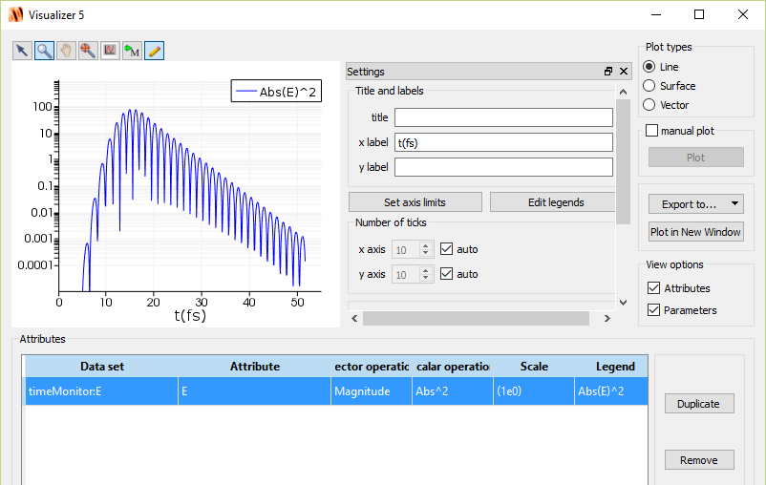
Analyze time-domain result
Next we must linear fit the energy curve. This can be done through Lumerical scripting interface.
Can also export data and use scripting to fit (Matlab, Python, Excel, etc)

Slide 47
Create time monitor
Q = 7.5

Slide 48
Next time
Intro to waveguides and MODE simulation

